Slide 1
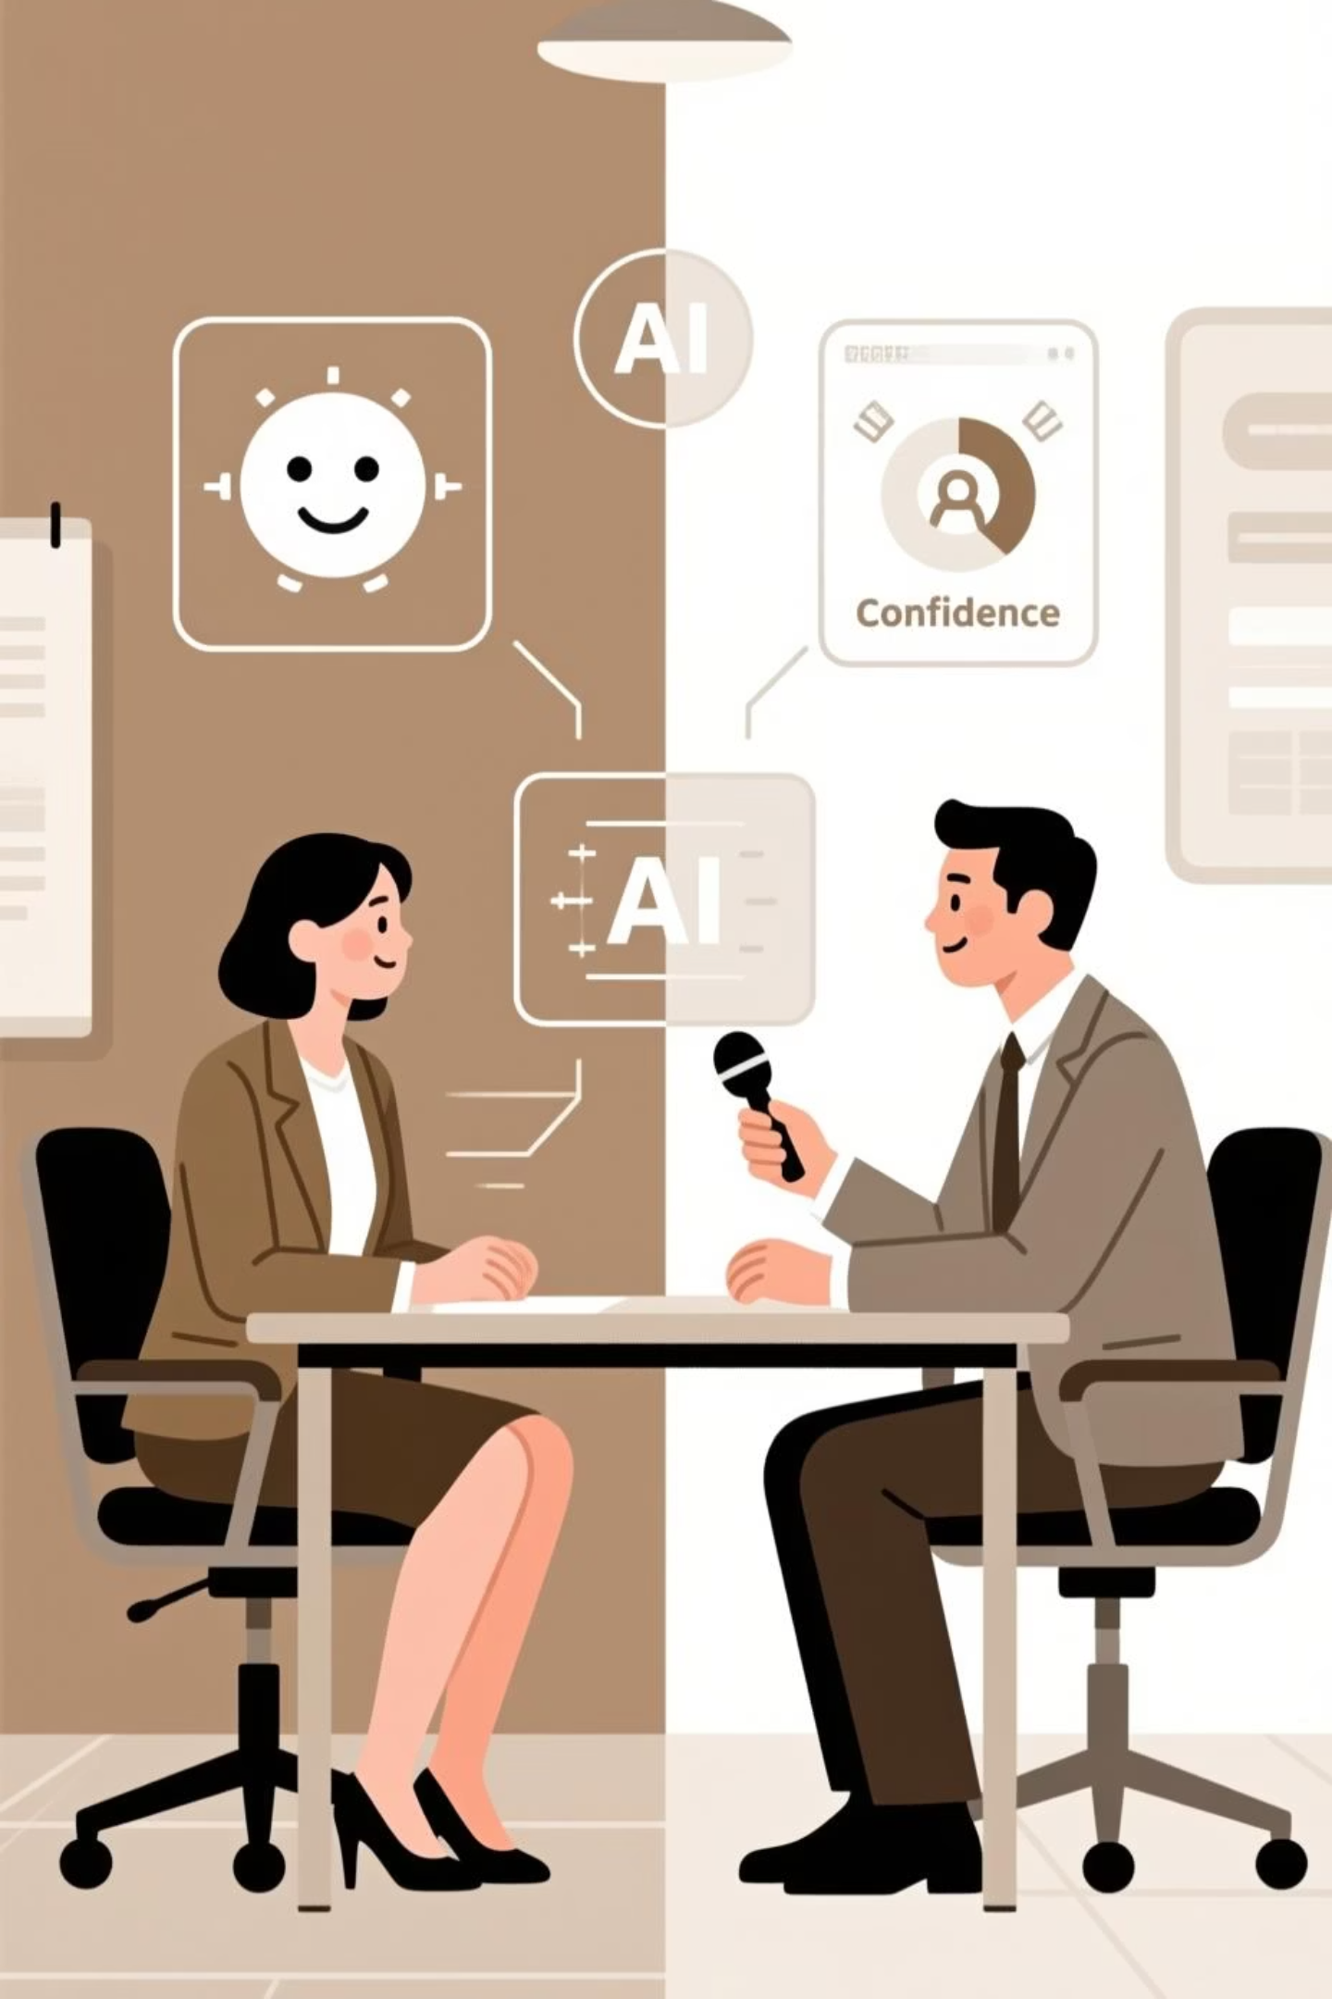
AI-Powered Interview Performance Analyzer
Real-Time Emotion & Confidence Assessment System
Making interview evaluations objective, data-driven, and fair.
Track 2 : Vertical Applications(AI for Workforce and HR).
Theme : Decode the unspoken side of human potential.

Slide 2

The Problem with Traditional Interviews
Subjective Assessment
Interviewer bias affects decisions. Inconsistent criteria and personal preferences influence scores.
Missed Signals
Subtle emotional cues overlooked. Non-verbal communication ignored. Confidence levels hard to measure.
Time-Consuming
Manual note-taking during interviews. Hours spent analyzing. Difficult to compare candidates objectively.
No Concrete Data
Vague feedback like "seemed nervous." No quantifiable metrics. Hard to justify hiring decisions.

Slide 3
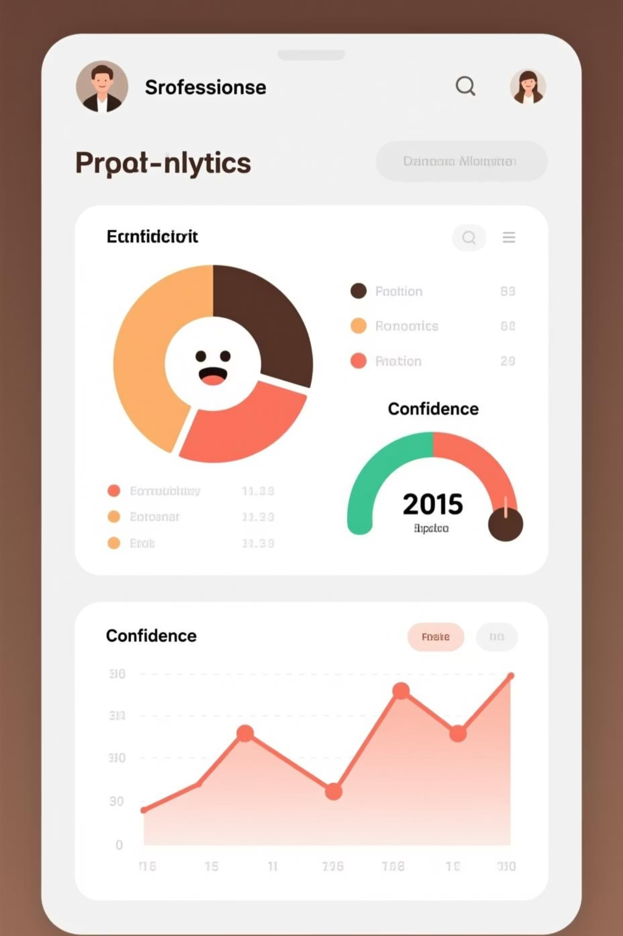



Our Solution: Real-Time AI Analyzer
Comprehensive analysis across three dimensions, delivering an 85/100 performance score with actionable insights.
Facial Emotions
Detects happiness, confidence, nervousness. Tracks emotional stability and engagement throughout the interview.
Voice Tone
Analyzes speaking confidence, pitch, energy levels, fluency, and hesitation patterns in real-time.
Speech Analysis
Evaluates professional vocabulary, response structure quality, and overall communication effectiveness.

Slide 4
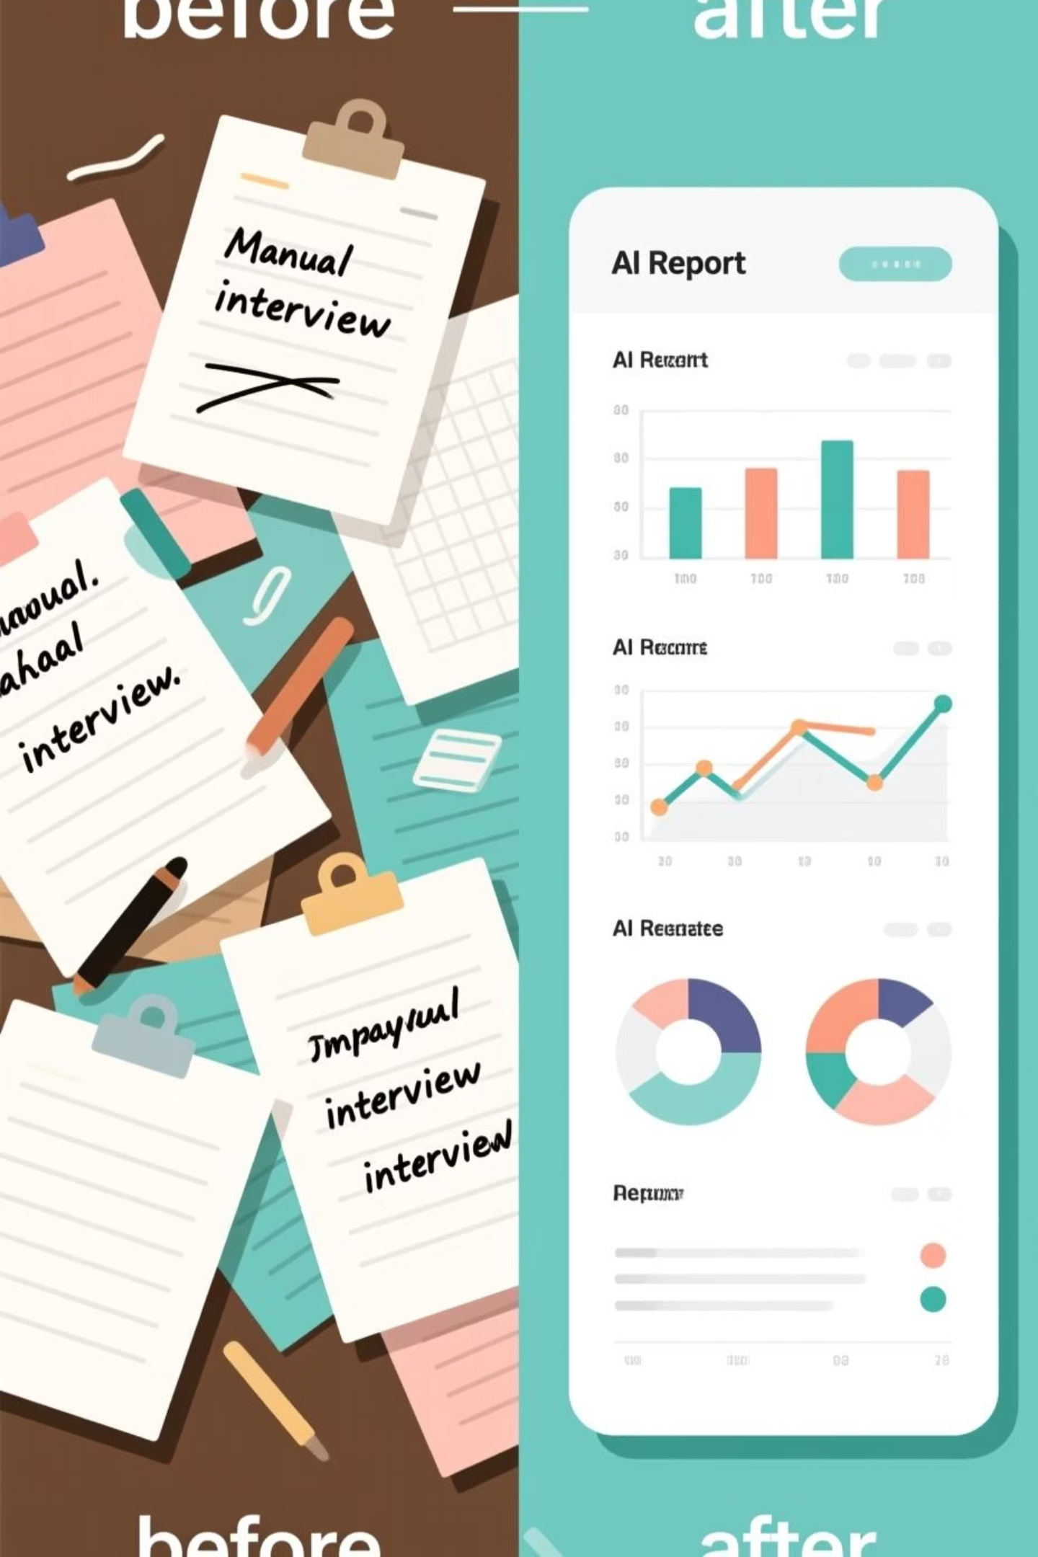

How It Works
Start Interview
Click "Start Recording." Camera captures facial expressions. Microphone records voice.
Real-Time Analysis
AI detects emotions every second. Voice tone analyzed continuously. Live feedback displayed on screen.
Get Instant Report
Comprehensive performance summary with emotion timeline, confidence breakdown, and interview transcript with insights.

Slide 5
Impact & Results
For Recruiters
For Candidates
Objective, data-driven decisions
Fair, unbiased assessment
80% faster evaluation time
Immediate performance feedback
Consistent scoring across candidates
Clear improvement areas
Reduced unconscious bias
Practice tool for preparation
Detailed evidence for decisions
Equal evaluation standards
85
7
100%
Average Performance Score
Emotions Detected
Objective Assessment

Slide 6
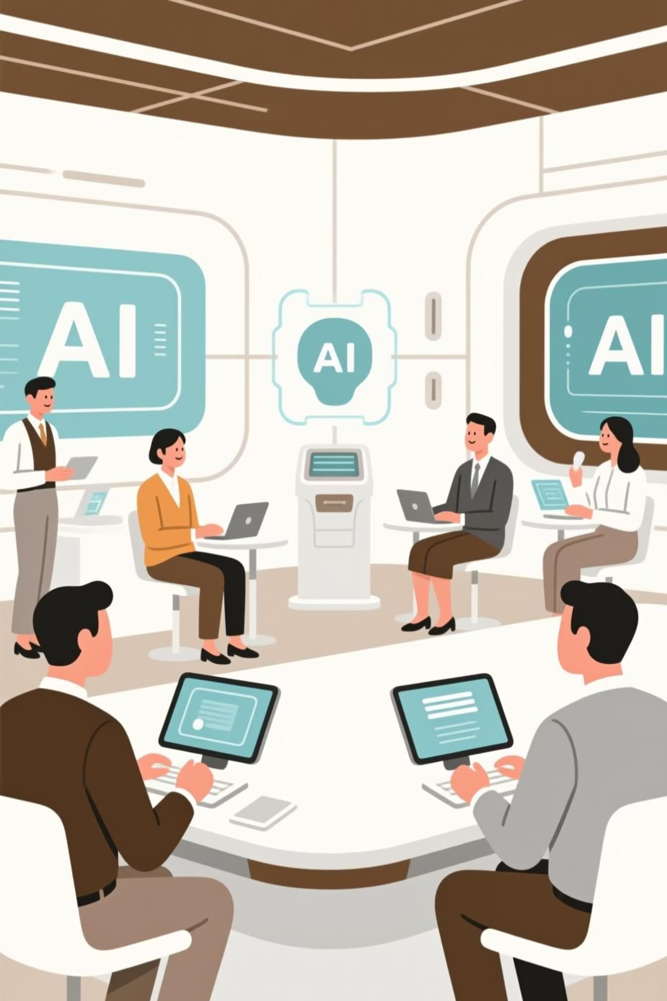

The Future of Interviews is Here
Making hiring fairer, faster, and smarter with AI.
Ready to transform your interview process? Experience objective, data-driven hiring that reduces bias and accelerates decisions.

